Slide 1
High resolution CT-based characterization analysis of idiopathic pulmonary fibrosis
Yuwen Zhang
Supervised by : Prof. Merryn Tawhai
Dr. Alys Clark
Dr. Haribalan Kumar
Notes:
Good morning, everyone, I’m Yuwen Zhang. In the next 15 minutes, I will make a introduction of my research, which is about quantitative analysis of idiopathic pulmonary fibrosis abnormality from CT imaging.

Slide 2
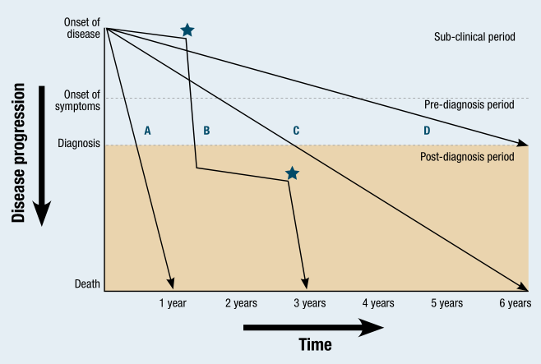
Background
Idiopathic pulmonary fibrosis (IPF) is a chronic and life-threatening disease
Cause is unknown
Etiology remains elusive
Progression is variable and unpredictable
Notes:
IPF is one of the most aggressive and frequent forms of idiopathic lung disease. Idiopathic means that the cause is unknown. For people more than 75 years old, IPF is estimated to occure in more than 200 cases per 1000,000. That is a large number of people with a disease that has no known cure, and a mean survival of only approximately 3 years. The etiology of IPF remains elusive and there is no known cure. The rate of progression of IPF is quite variable and unpredictable between patients, Some studies indicate that 15% of patients with IPF experience a rapid worsening of symptoms, insufficiency of pulmonary function and over 80% of these rapid progressive patients die of respiratory failure within 6 months. Most IPF patients deteriorate relatively slowly, and their pulmonary function usually decreases gradually over the months to years after the first clinical symptoms. However, there are currently no reliable biomarkers that indicate the likely progression of IPF disease.

Slide 3
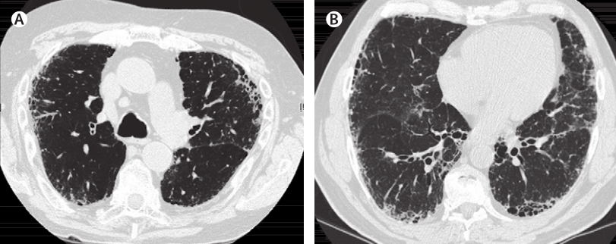
Background
HRCT is an essential tool in evaluating lung disease
Associated with the presence of a usual interstitial pneumonia (UIP) pattern on HRCT (ATS/ERS criteria)
Honeycomb, reticular, ground-glass
Combined IPF and emphysema (CPFE)
Notes:
Recent development in radiological imaging techniques offers exciting opportunities to provide radiological patient-specific biomarkers as important indicators of specific phenotypes. High-resolution computed tomography (HRCT) has played an essential role in evaluating lung disease through recognizing visual patterns and features of disease regions such as ground-glass opacities, reticular patterns and honeycombing. Based on the criteria set by members of ATS / ERS [5], the diagnosis of IPF usually associates with the presence of a usual interstitial pneumonia (UIP) pattern on HRCT. Honeycomb, reticular and ground-glass are all typical CT patterns of fibrosis disease. In addition, combined IPF and emphysema (CPFE) has been mentioned and defined in the past ten years. Some researchers suggest that CPFE should be regarded as a distinct clinical entity other than emphysema or IPF alone. Therefore, our research also involves in quantitative analysis of emphysema region on HRCT image.

Slide 4

Summary of published work
Quantitative analysis of radiology:
Adaptive multiple feature method (AMFM), mean lung attenuation (MLA),
texture-based scoring systems
Clinical functional measurements:
Pulmonary functional tests (PFTs), airway resistance/tissue compliance,
ventilation/perfusion ration
Limited research into combining spatial data with functional data.
No established quantitative tools to assess the progression of IPF
Aim: Develop a new method for quantitative assessment of the IPF lung bringing together volumetric imaging, pulmonary function tests, and computational models for lung function.
Renuka et al(1999), Alan et al (2008), Wang et al (2003, 2008), Hyun et al (2010, 2011, 2015)

Slide 5
Imaging and clinical data
Clinical data assessed in this study
Age (years) | 43-82
Females/Males | 3/5
Slice thickness (mm) | 1.25-3.00
Interval between scans (months) | 5-20
Slice resolution | 512x512
Number of slices | 65-160
The clinical data used in this study comprised HRCT images and pulmonary function tests obtained from 8 patients diagnosed with IPF at Auckland City Hospital, Auckland, New Zealand.
5 patient 1 time point
1 patient 2 time point
2 patient 3 time point
Notes:
The clinical CT data used in this study was acquired from 8 patients diagnosed with IPF at Auckland City Hospital. The slice thickness of these clinical CT images are from 1.25 to 3.00mm. Among these data, 5 patients have one time point, 1 patient has 2 time point data, 2 patients have 3 time point data. The time interval between different time point is between 5 to 20 months.

Slide 6
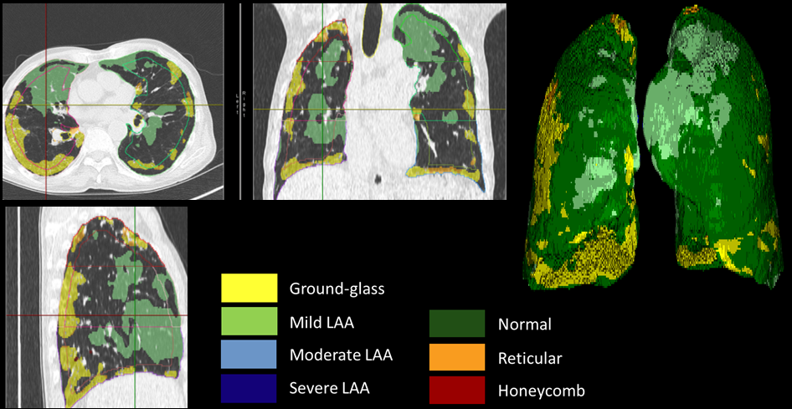
Pulmonary parenchymal classification
CALIPER (Computer-Aided Lung Informatics for Pathology Evaluation and Ratings) software.
Mayo Clinic (Rochester, MN, USA)
Each parenchymal voxel was classified into the following characteristic CT patterns: normal (N), reticular (R), honeycomb (HC), ground-glass (GG), mild low attenuation areas (LAA), moderate LAA and severe LAA. Emphysema : Hounsfield Unit is under -950.
a
b
d
c
Color labelled classification result of case 7 on IPF HRCT by CALIPER. (a) Transverse plane. (b) Coronal plane. (c) Sagittal plane. (d) 3D color labelled lung.
Notes:
Tissue regions were classified using CALIPER (Computer-Aided Lung Informatics for Pathology Evaluation and Ratings) software. CALIPER is a computational image analysis platform developed by the Biomedical Imaging Resource Laboratory at the Mayo Clinic Rochester for the characterization and classification of lung parenchymal findings on CT images. CALPER classifies regions of the lung every parenchymal voxel into the following characteristic CT patterns: normal (N), reticular (R), honeycomb (HC), ground-glass (GG), mild low attenuation areas (LAA), moderate LAA and severe LAA. In addition, emphysema areas were extracted through detecting the voxels whose Hounsfield Unit is under -950.

Slide 7
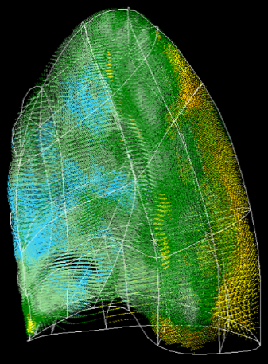
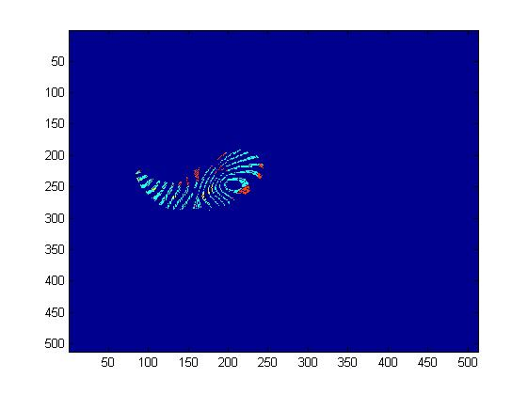
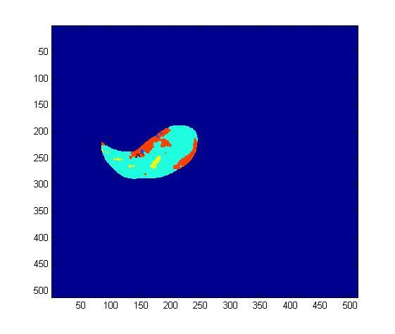
Normalization of classified data
Lung mesh : bi-cubic Hermite finite element surface mesh (left lung: 35 nodes and 44 elements; right lung: 50 nodes and 62 elements)
Statistical shape model (SSM): 30 healthy normal subjects (15 males and 15 females), principal component analysis (PCA)
Lung surface mesh fitting
Map classified data mapping to SSM
KNN searching
Fill gaps in mapped data
Classified data
Notes:
Lung surface data was extracted from the classified data and fissure surfaces were defined manually using the open-source visualization software CMGUI by an expert user. A bi-cubic Hermite finite element surface mesh was fitted to the shape of the lung and its fissures via a least squares fit. The left lung mesh consists of 35 nodes and 44 elements, while the right lung mesh has 50 nodes and 62 elements.
There is lung shape variation between different subjects and often between clinical images obtained at different times. classified volumetric lung data was then mapped to a statistical shape model (SSM) of the ‘normal’ older human lung to provide a consistent mapping of tissue abnormalities between and within individuals to a same lung shape. The statistical shape model was constructed based on principle component analysis derived from a set of training meshes. The training set consisted of data from 30 healthy normal subjects (15 males and 15 females) that was retrospectively selected from the Human Lung Atlas (HLA) database.
In order to map the data, we need to calculate the xi location of each data point within its correspond element, and then use this xi to calculate the global coordinates of the mapped data points.
Next, we projected the mapped data into a series of cross section slices. From the first row image, we can see that there are some curved gaps within the mapped data, that is caused by the deformation during the mapping.
In order to make the data points distribute uniformly throughout each lung, the gap sin of the mapped data caused by the deformation. The gaps were filled to match their closest neighbor point among the classified data, so that it could be easier for the further volume and density quantitative analysis.

Slide 8
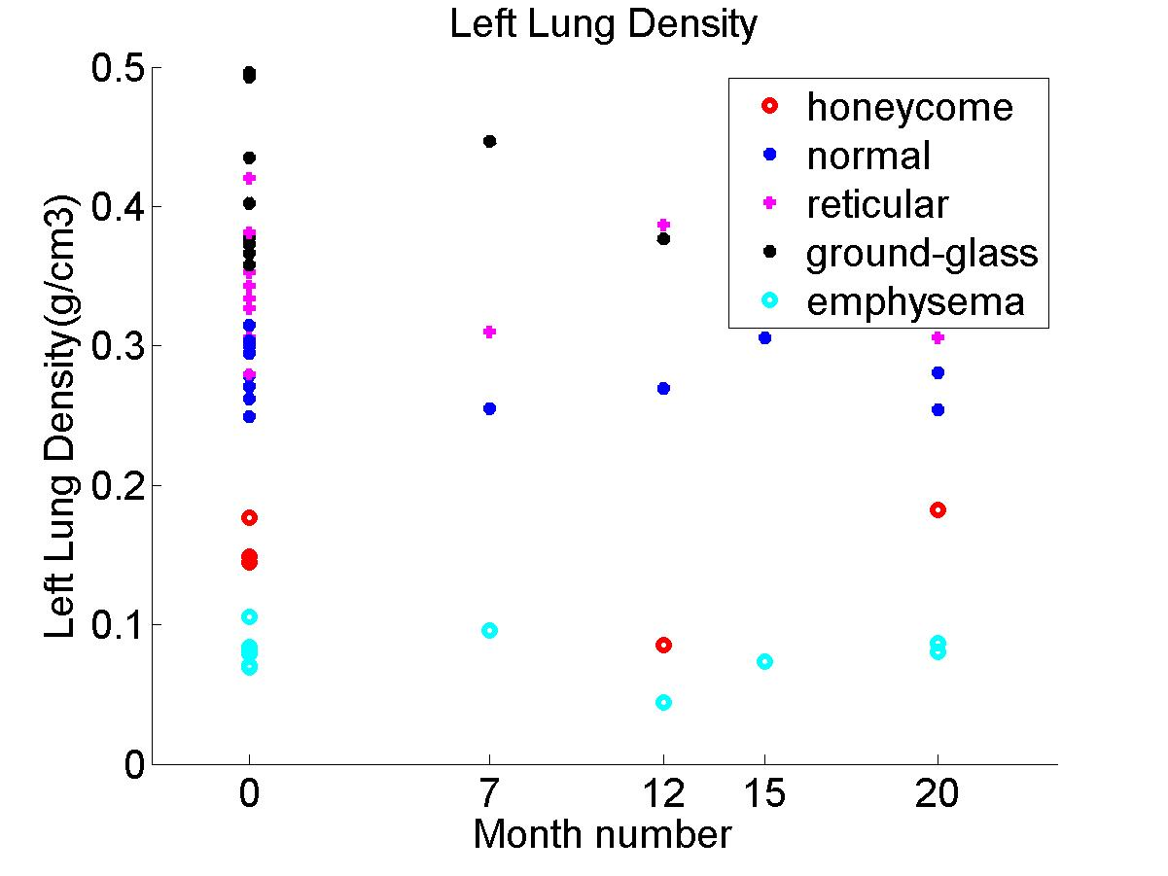
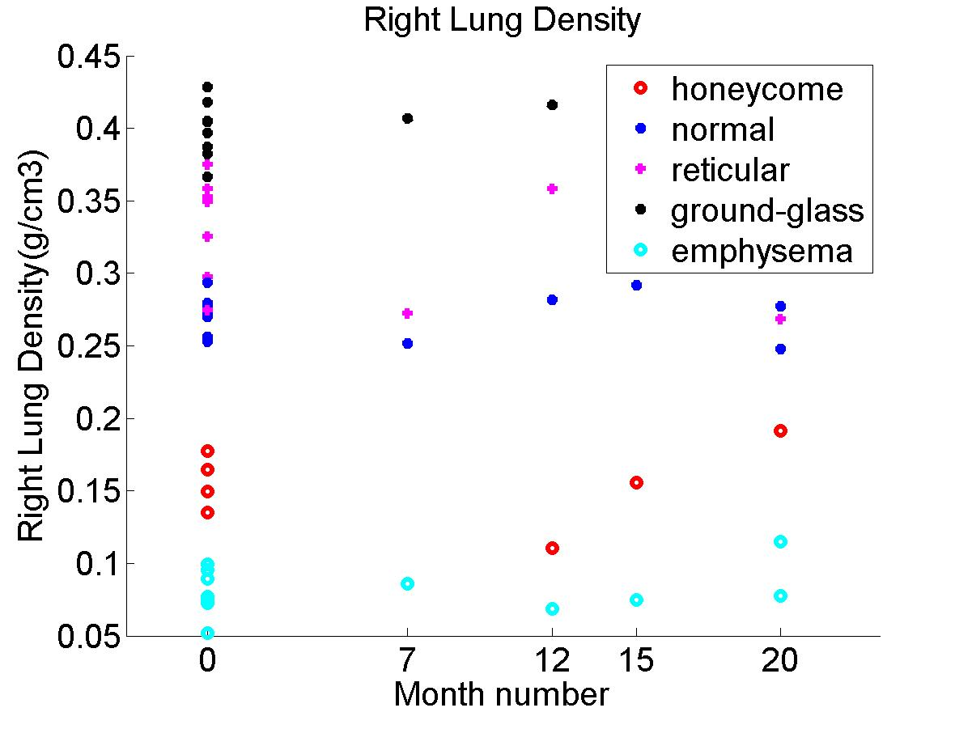
Density analysis
Fibrosis usually has a consistently higher tissue density (0.34/0.41 for reticular/ground-glass) compared to normal tissue (0.27) over time
In contrast, emphysema has lower density (0.078)
Notes:
The average density value of each classified CT pattern for each subject was calculated. From the result, we can see the average density of each region almost remains consistent over time, and for one region, the tissue density usually slightly fluctuates within a specific range. the average density of each region almost remains consistent over time, and for one region, the tissue density usually slightly fluctuates within a specific range. Fibrosis usually has a consistently
higher tissue density (0.34/0.41 for reticular/ground-glass) compared to normal tissue (0.2752) over time. In contrast, emphysema has lower density (0.0784).
The volume of left and right lung for each patient was calculated. From this table, we can see the lung volume of IPF patients keeps an overall decreasing over time. The lung volume decreased by about 11.85% averagely for these three patients.

Slide 9
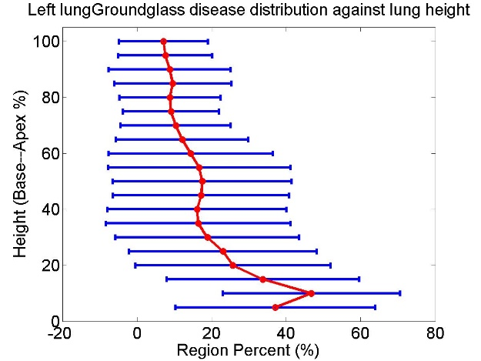
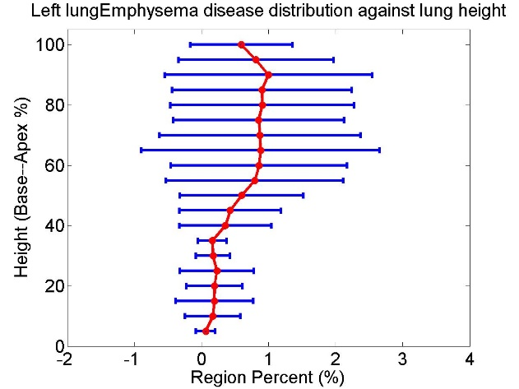
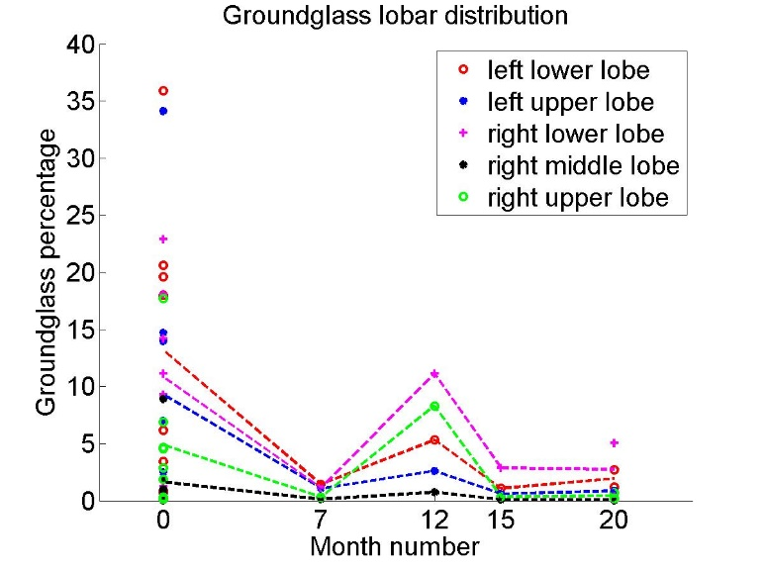
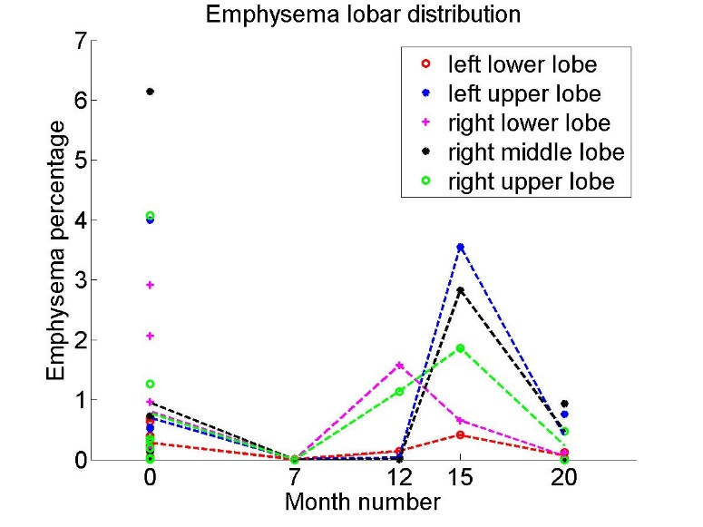
Spatial distribution analysis
Ground-glass
Emphysema
Fibrosis mostly located in lower lobes (72%, 58%, 65% for honeycomb, reticular, ground-glass)
Emphysema mostly located in upper lobes (73%)
Notes:
In the direction from base to apex, the volume percentage of each disease region was averaged in 5% percent lung height (along the dorsoventral axis). It can be seen from the result that ground-glass region mainly locates in the basal part of lung. The percentage of ground-glass decreases gradually with the increasing of the lung height. In contrast, the percentage of emphysema roughly keeps a rising trend along with the increasing of lung height. The distribution of reticular region mainly focuses on the basal area and apex area. This kind of disease CT pattern seldom appears in the middle part of lung. The distribution of honeycomb seems not to have a regular distribution against lung height.
Also, the volume percentage of each disease region for each lobe was calculated to provide a lobar distribution of disease.
For ground-glass and honeycomb patterns, it can be seen from the figure that the disease regions mostly locate in the lower lobe of each lung. For reticular pattern, the percentage of middle lobe is significant lower than the percentage of other lobes, which probably means reticular pattern hardly locates in the middle part of lung. As for emphysema lesions, it commonly distributes in the upper lobes and with the increasing of time, it may also appear in the middle lobe.

Slide 10
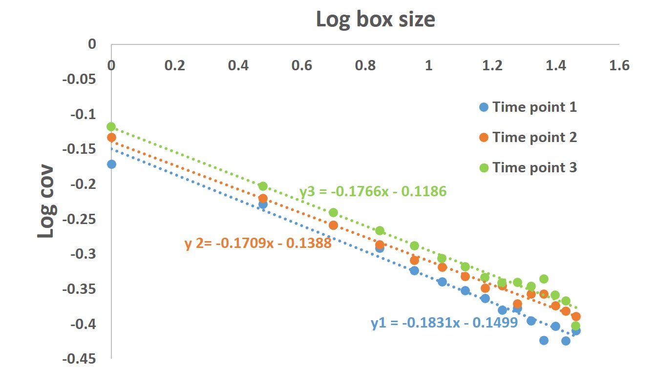
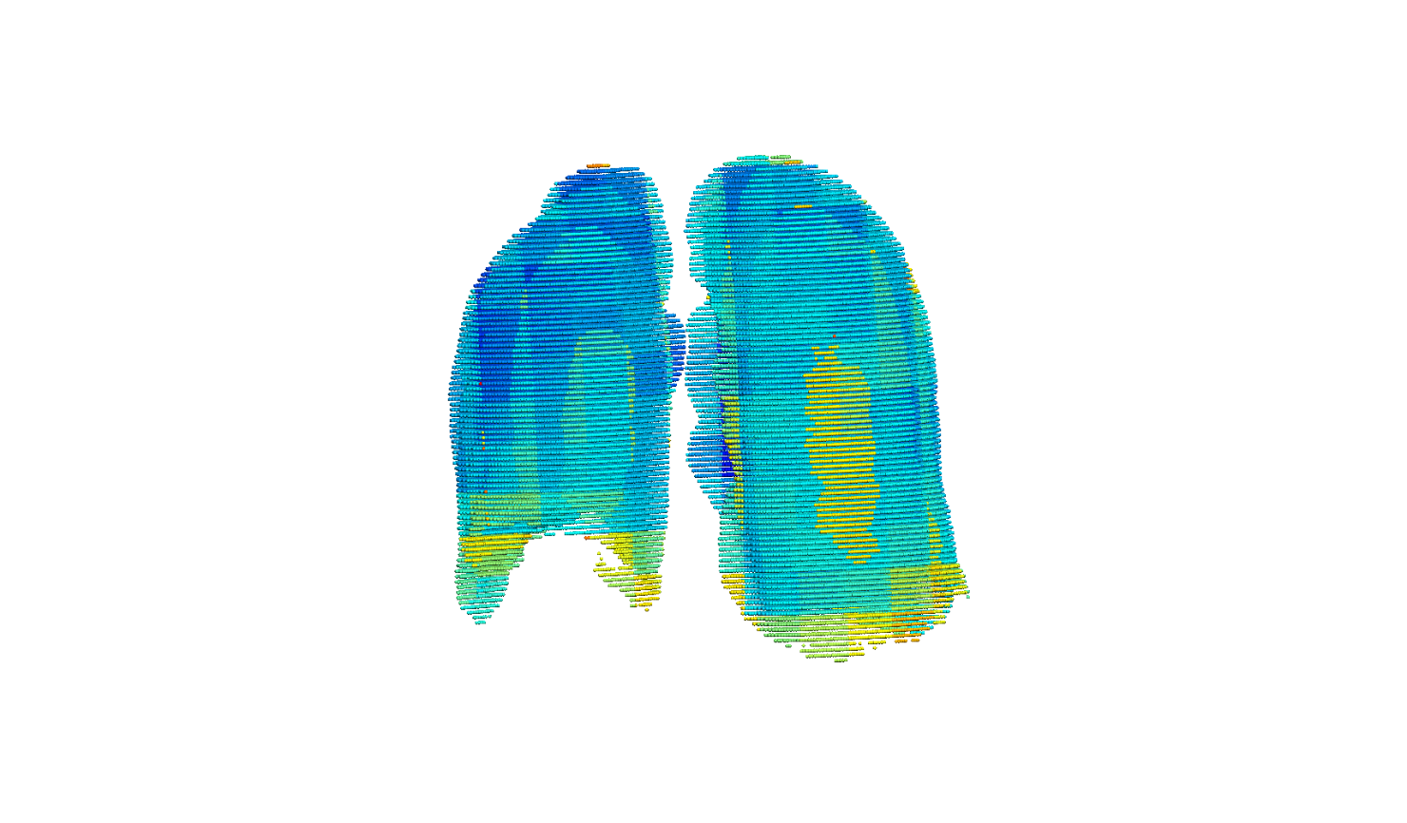
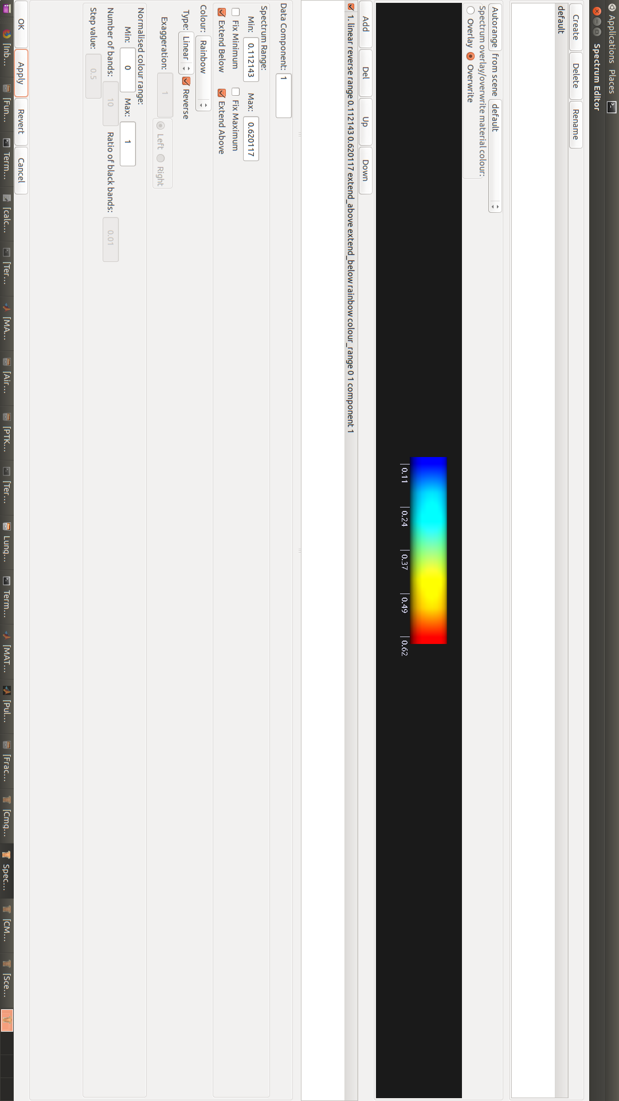
Heterogeneity analysis
3D grid density visualization
Fractal dimension for density: fitting a straight line for the relationship between coefficient of variance (COV) and sampling window size.
FD = 1 – gradient of log-log curve
Heterogeneity is relatively constant over time.

Slide 11
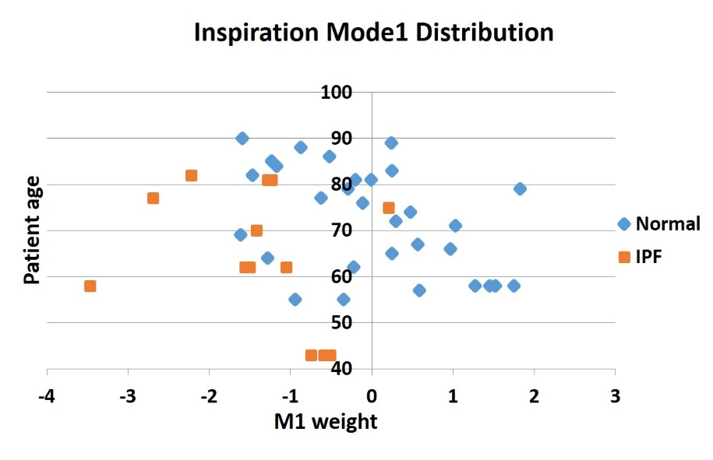
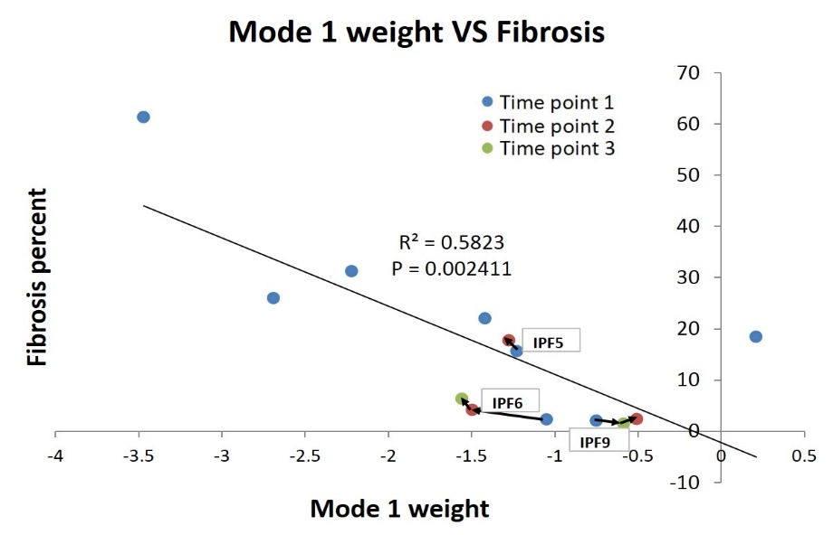
SSM based shape analysis
Training data collection
(35 older normal)
Principle component shape feature analysis
Statistical shape model construction
Specific subject projection
The first principal SSM mode relates to the anteroposterior diameter of the lung, and the ratio of apical and basal diameters
The first principal SSM mode (>20% of the shape variation in normal lungs) is significantly different between IPF and normal .
For IPF subjects, the first mode has a strong relationship with fibrosis percent.

Slide 12
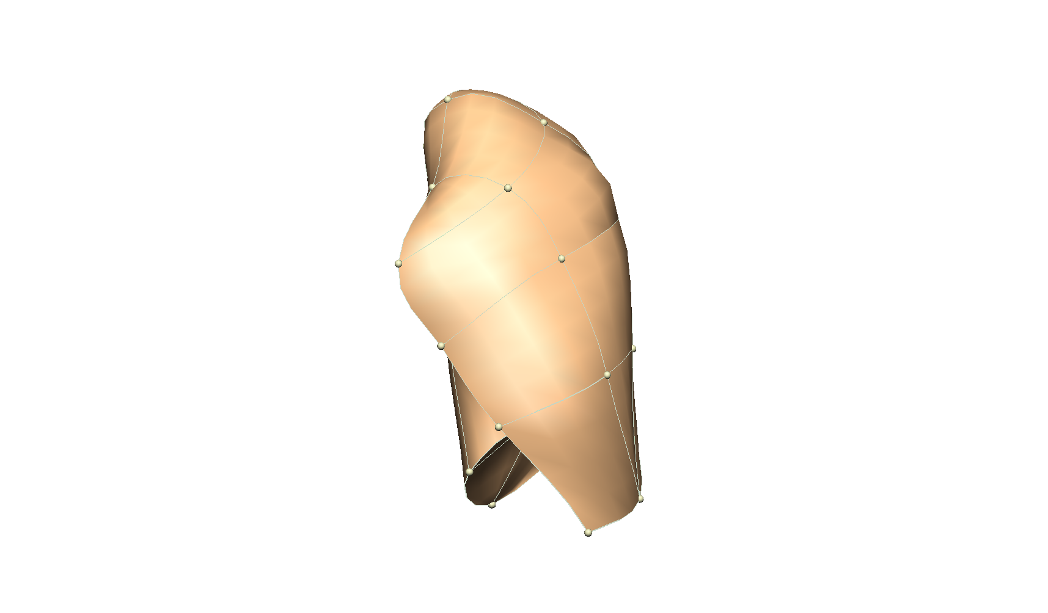
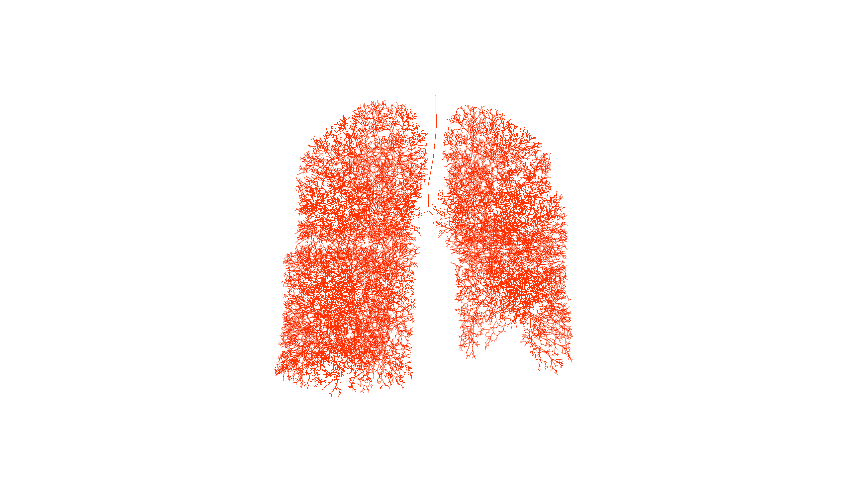
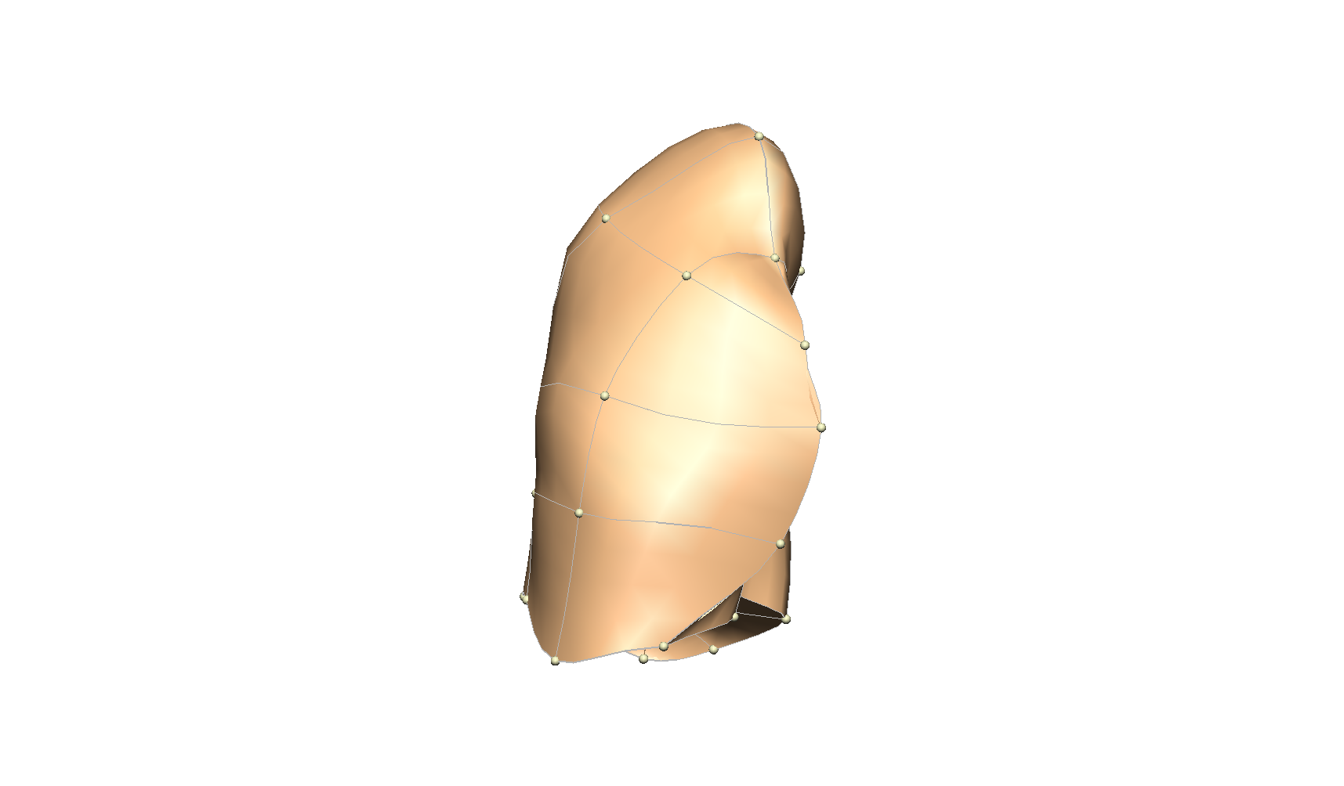
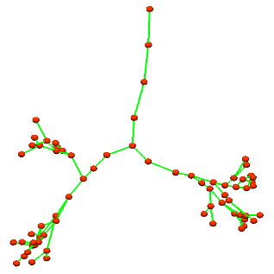
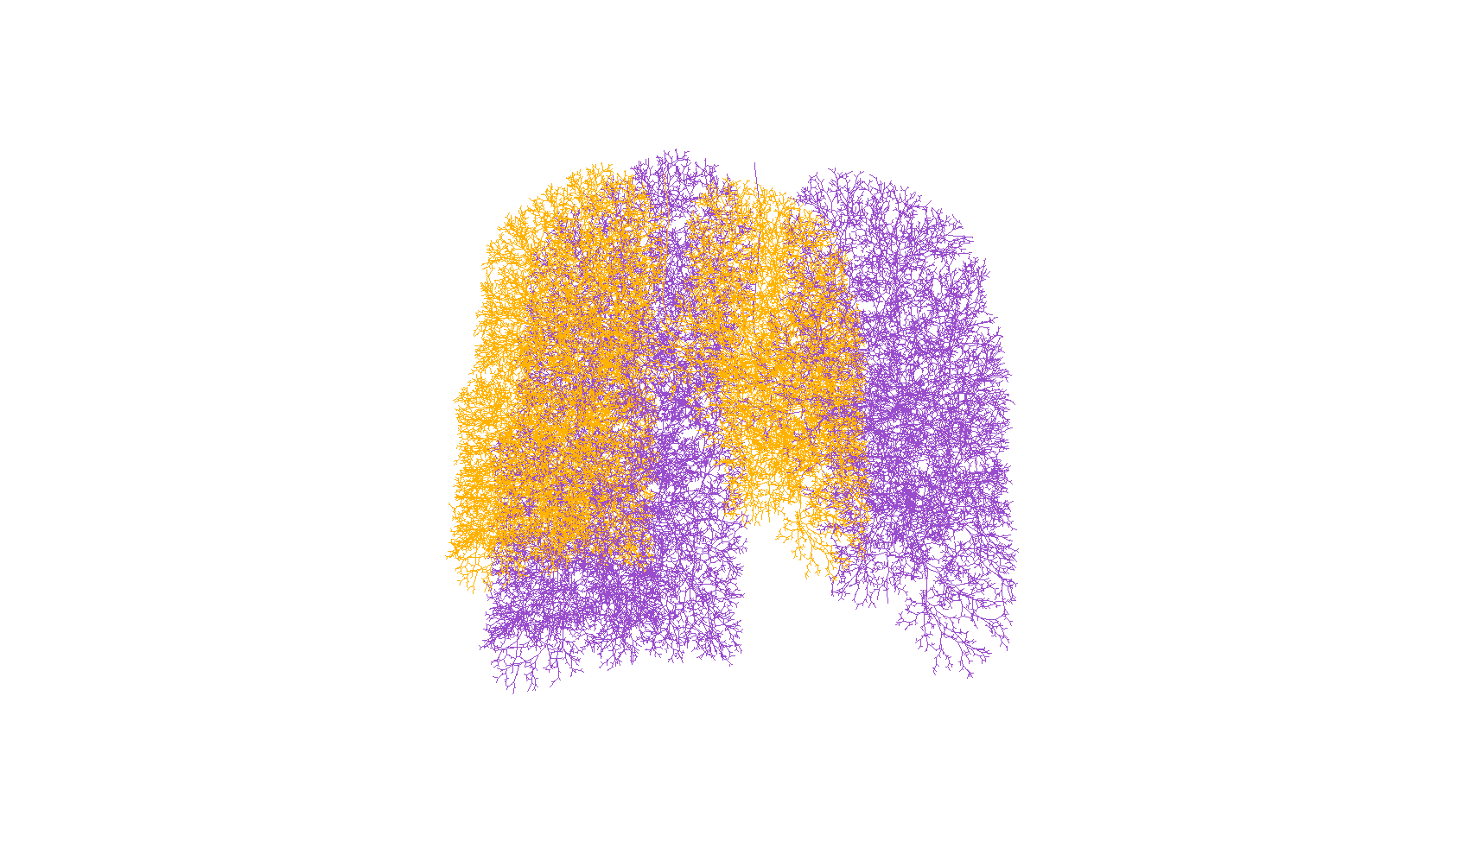
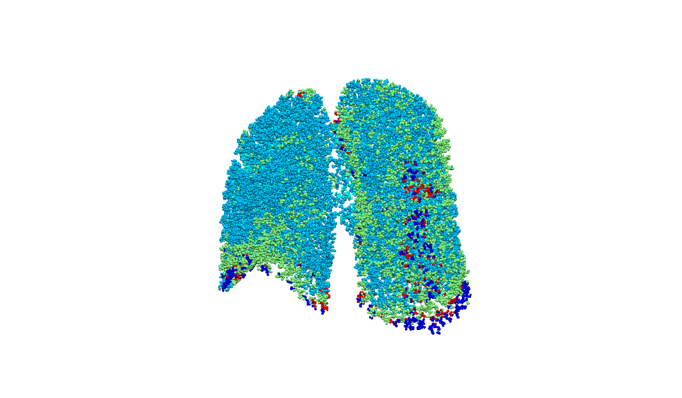
IPF patient-specific airway tree geometry
Manually digitize upper airway
Generate full airway tree of time point 1
Map first airway tree to other time points
Disease spatial distribution
Disease percentage against gravitational height
Scale the airway tree (length and radius) to FRC volume
Label each terminal acinar unit with different CT patterns
Notes:
Our current work is to use the previous quantitative analysis as image-level biomarkers to drive a ventilation analysis. Here is a brief workflow of the model nbased analysis. Firstly, the upper airway tree was manually digitized using cmgui. Then, for each patient, generate full airway tree of the first time point, map this airway tree to the lung volume mesh of other time points, this can make sure the same airway tree geometry was used for different time point. In the next stage, the airway tree terminal acinar unit was labelled with different CT disease patterns through matching the airway tree to the classified data. Different patient has different disease distribution, this patient-specific disease distribution can conduct a patient-specific ventilation analysis, such as change the resistance and compliance for different disease regions. Currently, we are working on the ventilation model, but a future goal is the use the quantitative analysis on our perfusion, gas exchange and mechanics model.

Slide 13
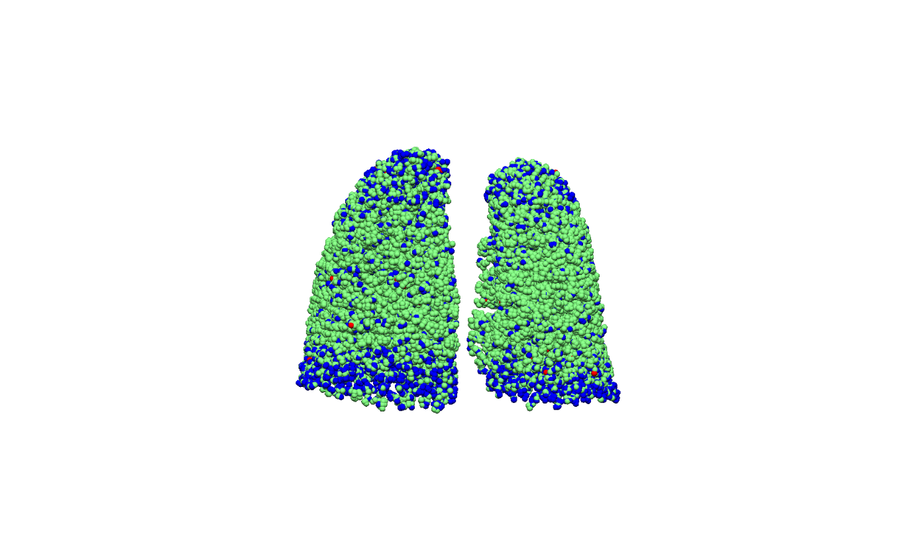
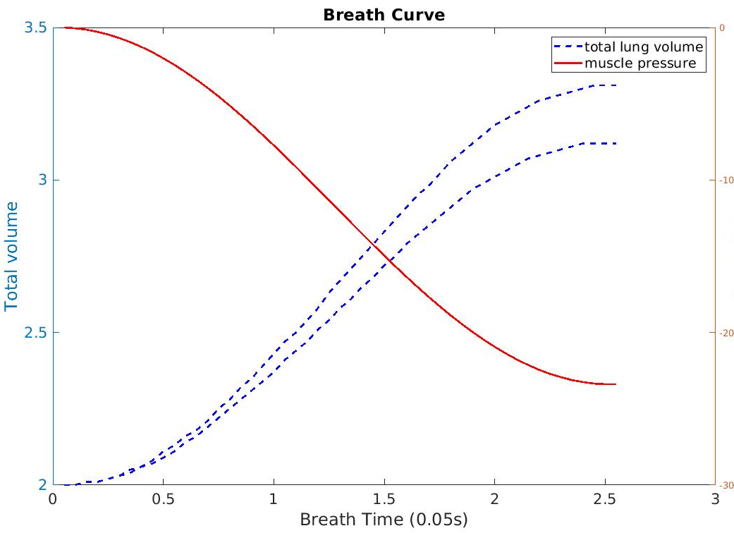
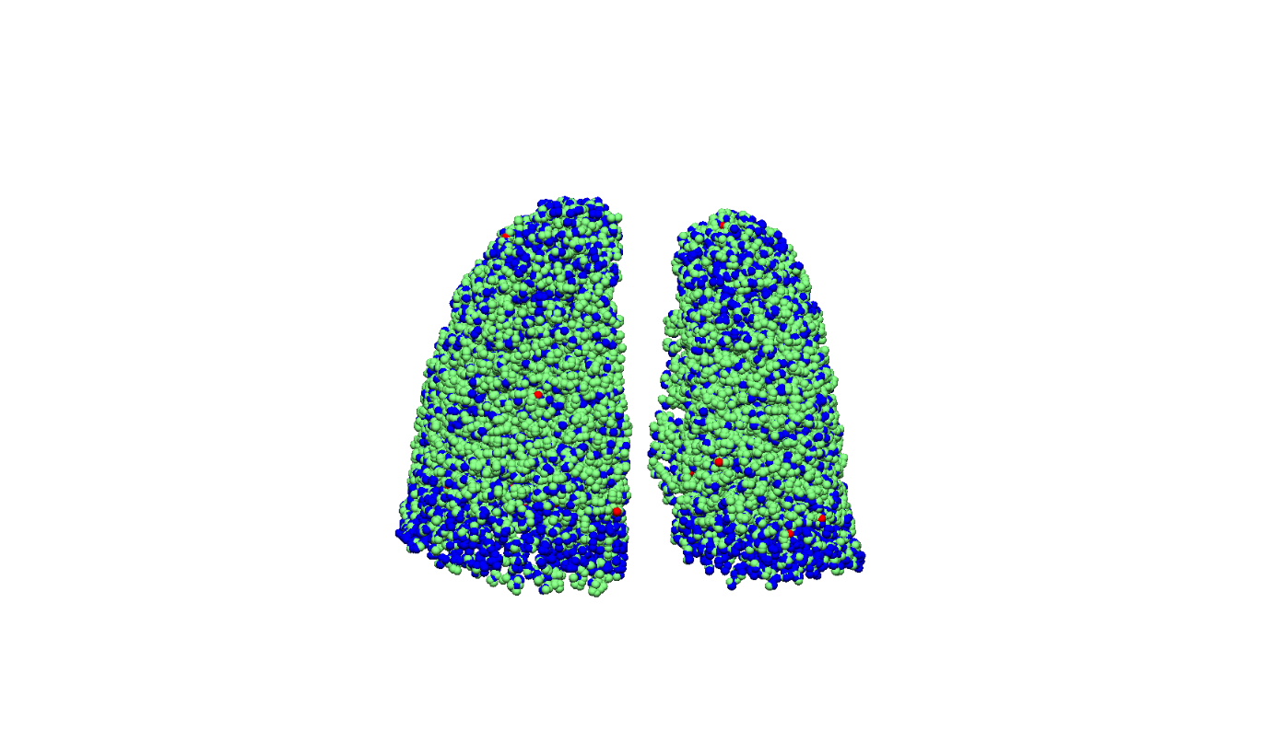
IPF patient-specific ventilation analysis
Forced inspiration
Reference FRC –TLC: set muscle pressure
Real FRC –TLC: set real abnormality distribution
Abnormalities on CT scan derived curve
Real inspiration curve
Fibrosis: 17.64%(from CT)
abnormalities on volumetric data are not sufficient to explain increased lung stiffness
Fibrosis: 29.75%

Slide 14
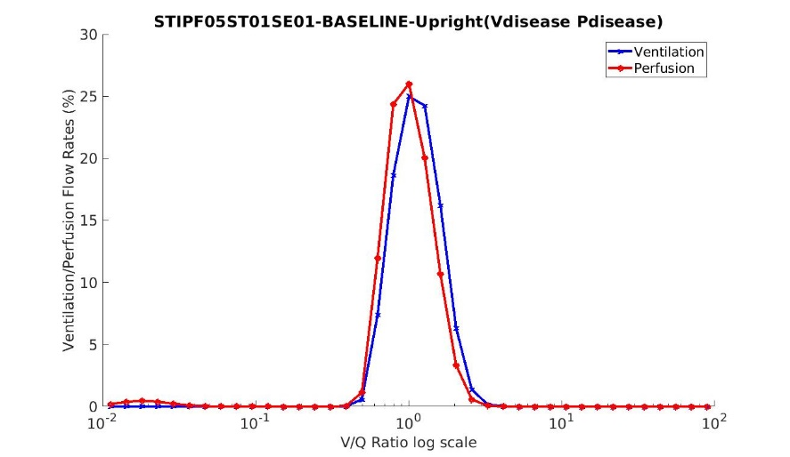
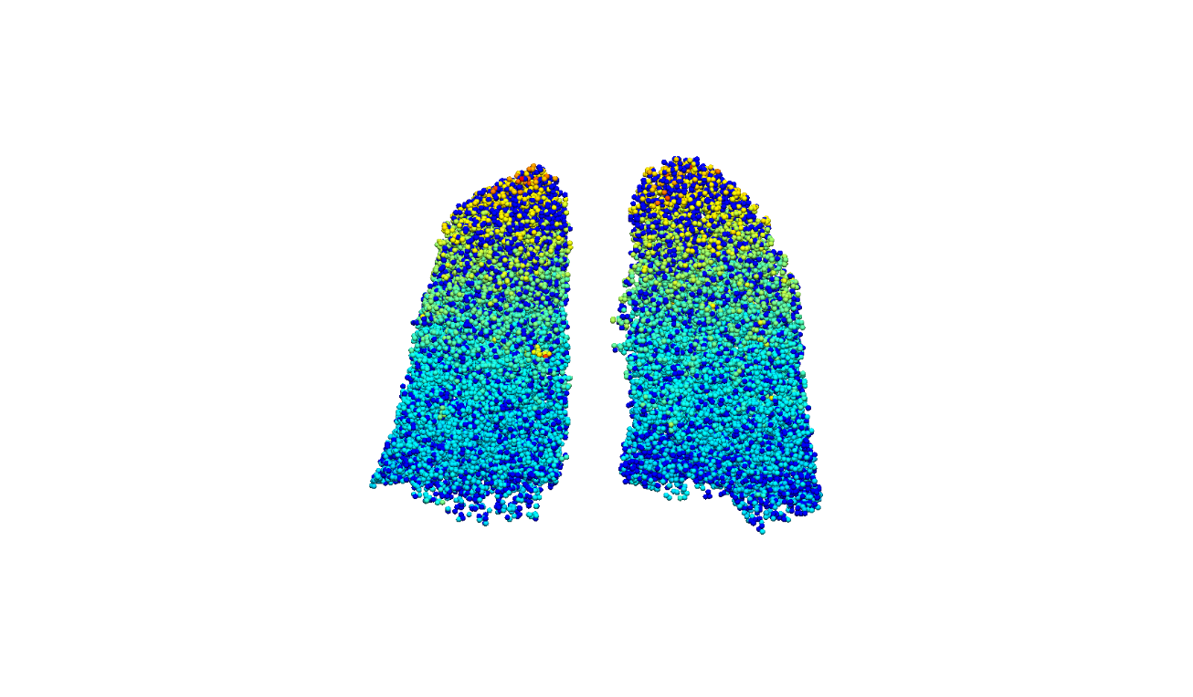
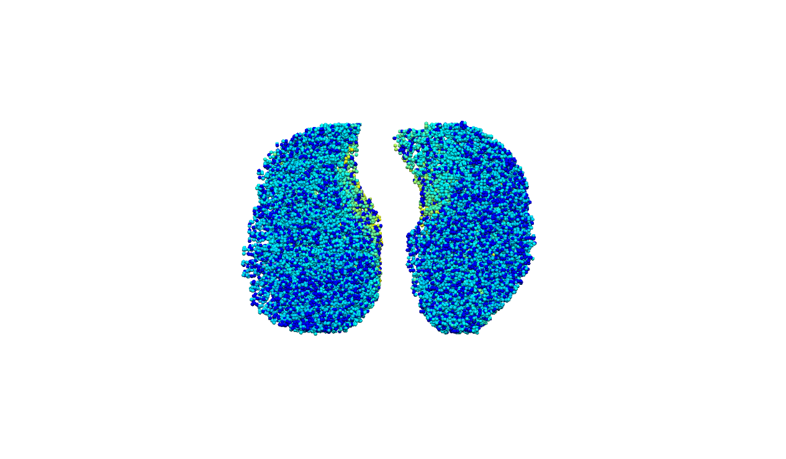
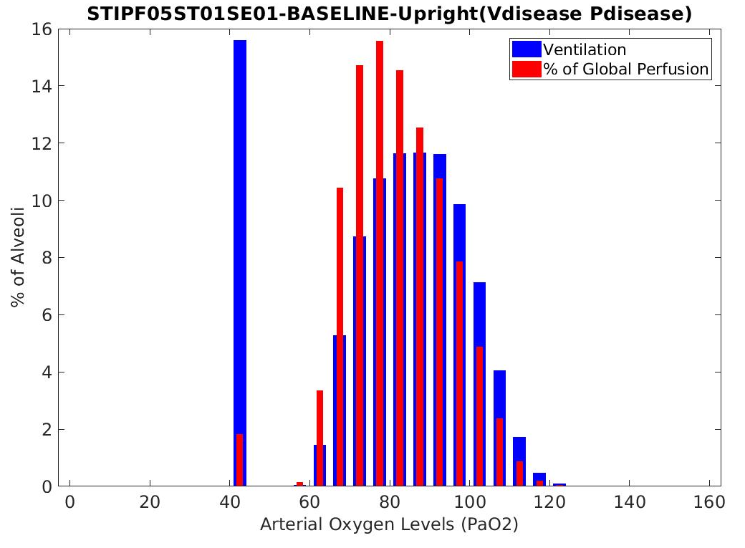
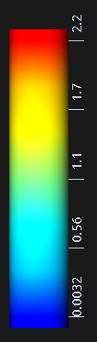
IPF patient-specific gas exchange analysis
Perfusion analysis:
parameterize the model inputs
generate vessel geometry
reduce the vessel radius of disease labelled region
V/Q ratio distribution
Notes:
For the patient-specific perfusion analysis, we generated the full vessel tree matching and surrounding by the airway tree. The vessel radius of the disease labelled region were decreased so that we can get a reduced perfusion of the abnormal regions. Using the ventilation and perfusion as input of the gas exchange model, we can get a V/Q ration distribution of IPF patient. We can observe from the result that V/Q mismatching could occur not only around the disease location but also happen on normal region. This part of work we are still working on, we need to take more factor into consideration, which lead to our future work.

Slide 15
Future work
Transfer factor: alveolar-capillary membrane area, thickness
Forced expiratory model combined with FEV1, FVC results
Tissue mechanical model combined with density and shape analysis results
Predict IPF development at an early stage
Notes:
In the next work, we may take the transfer factor into consideration. As for emphysema regions, the alveolar-capillary membrane area may become bigger, for fibrosis tissues, the membrane thickness become bigger, both of them will influce the transfer factor. We also plan to use more PFT data to parameterize our model, e.g. use FEV1 and FVC value to simulate the forced expiratory model. And use the density and shape analysis results on our tissue mechanical model to analyze the stree distribution of IPF lungs. Our further goal is to integrate all the analysis to make a prediction of IPF progression at an early stage to help with a clinical treatment.

Slide 16
Thank you

